Slide 1
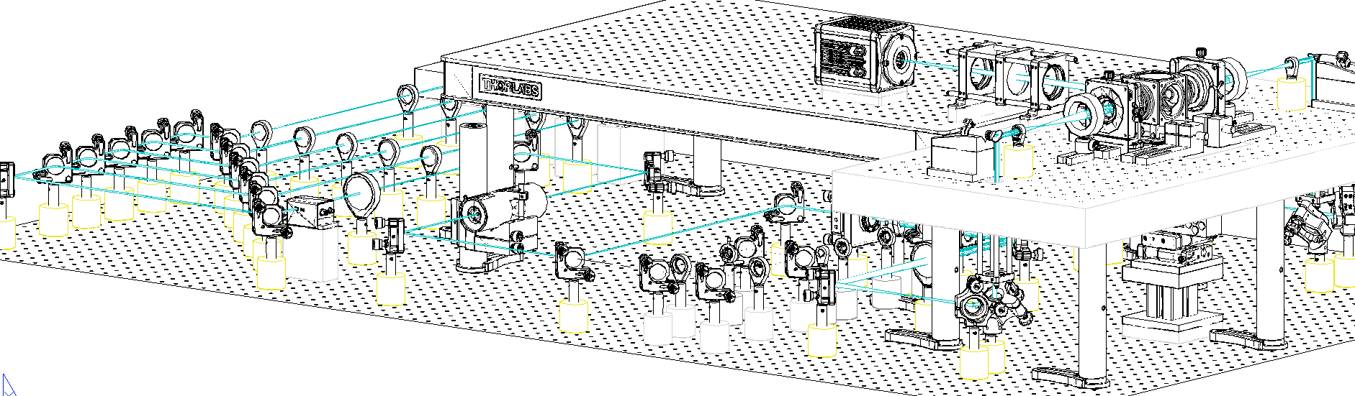
A
561 nm
515 nm
491 nm
445 nm
405 nm
Detection
Olympus
25×, 1.0NA
WD: 8mm
v
f 200
galvo
Camera
filter
f 200
f 50
f 140
f 350
f 100
v
f 200
Axicon
f 50
D
LP 552
PBS
LP 503
I
Nikon CFI LU Plan Fluor EPI 10×, NA 0.30, WD 17.5 mm
LP 466
I
f 350
f 150
LP 427
f 100
f 50
f 150
LM
f 50
C
AOTF
f 100
f 250
galvo
I1
I2
f 50
f 150
A
B
f 200
B

Slide 2
A
561 nm
515 nm
491 nm
445 nm
405 nm
Detection
Olympus
25×, 1.0NA
WD: 8mm
v
f 200
galvo
Camera
filter
f 200
f 50
f 140
f 350
f 100
v
f 200
LP 552
PBS
LP 503
Nikon CFI LU Plan Fluor EPI 10×, NA 0.30, WD 17.5 mm
LP 466
f 350
f 150
LP 427
f 100
f 150
LM
f 50
AOTF
galvo
I1
I2
f 50
f 150
f 200
B

Slide 3
A
561 nm
515 nm
491 nm
445 nm
405 nm
Detection
Olympus
25×, 1.0NA
WD: 8mm
v
f 200
galvo
Camera
filter
f 200
f 50
f 140
f 350
f 100
v
f 200
Axicon
f 50
D
LP 552
PBS
LP 503
I
Nikon CFI LU Plan Fluor EPI 10×, NA 0.30, WD 17.5 mm
LP 466
I
f 350
f 150
LP 427
f 100
f 50
f 150
LM
f 50
C
AOTF
f 100
f 250
galvo
I1
I2
f 50
f 150
A
B
f 200
B
Motor
stages
Periscope

Slide 4
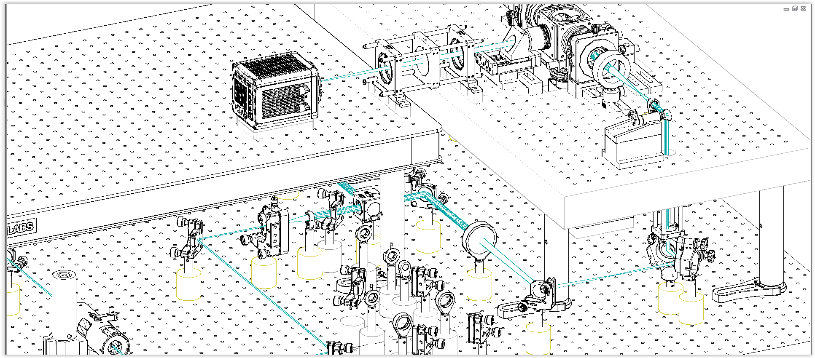
A
561 nm
515 nm
491 nm
445 nm
405 nm
Detection
Olympus
25×, 1.0NA
WD: 8mm
v
f 200
galvo
Camera
filter
f 200
f 50
f 140
f 350
f 100
v
f 200
Axicon
f 50
D
LP 552
PBS
LP 503
I
Nikon CFI LU Plan Fluor EPI 10×, NA 0.30, WD 17.5 mm
LP 466
I
f 350
f 150
LP 427
f 100
f 50
f 150
LM
f 50
C
AOTF
f 100
f 250
galvo
I1
I2
f 50
f 150
A
B
f 200
B

Slide 5
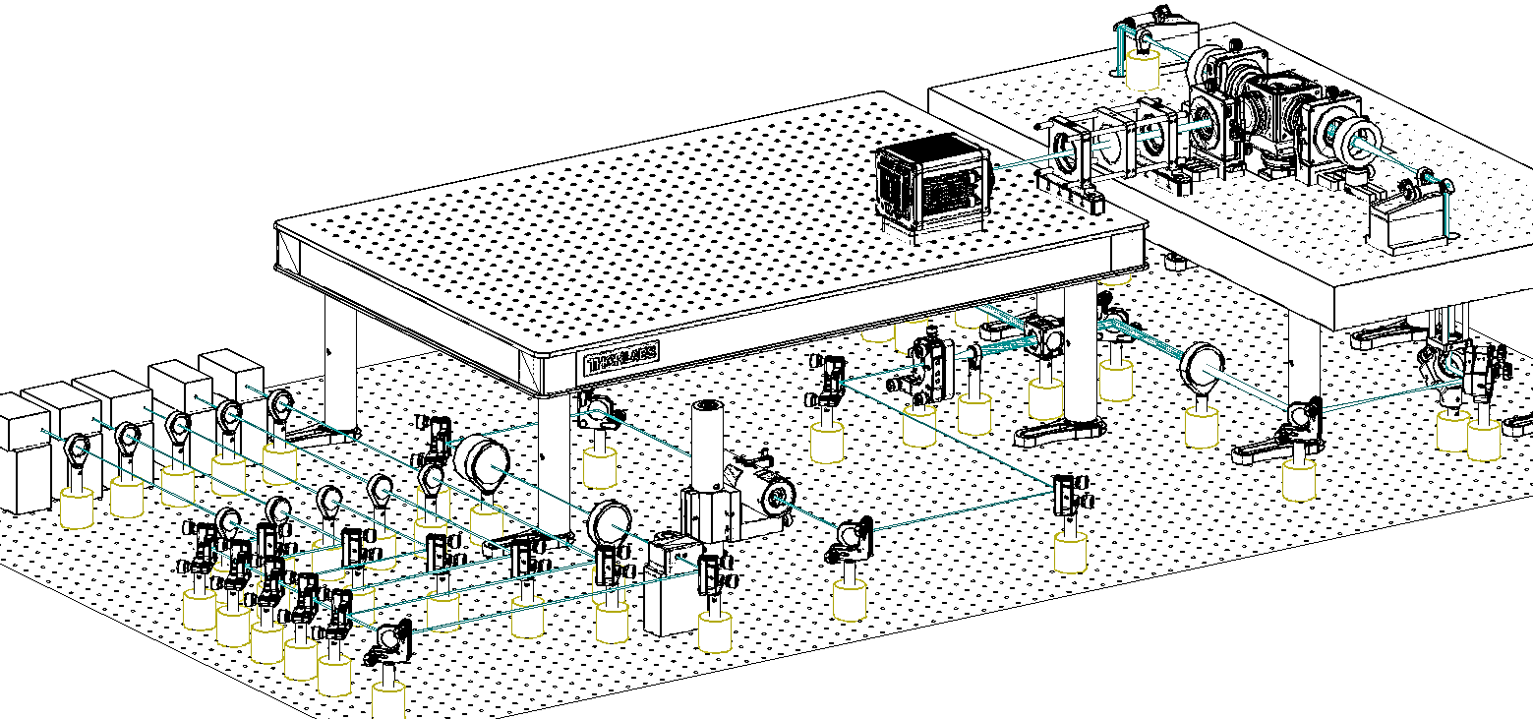

Slide 7
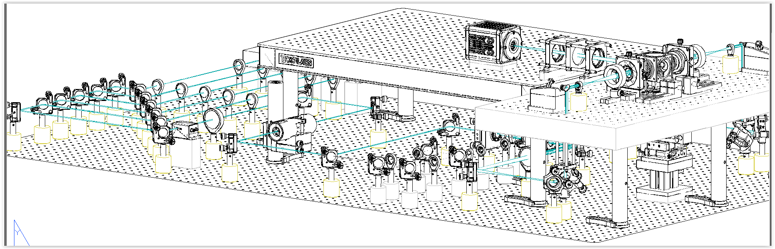

Slide 8
Olympus XLSLPLN25XGMP
25×, 1.0NA
WD: 8mm
Camera
f 200

Slide 9
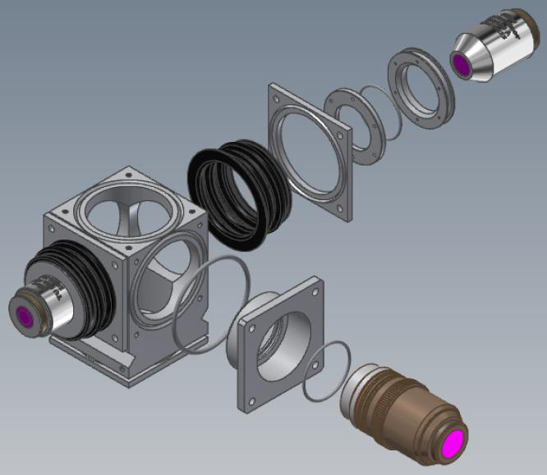
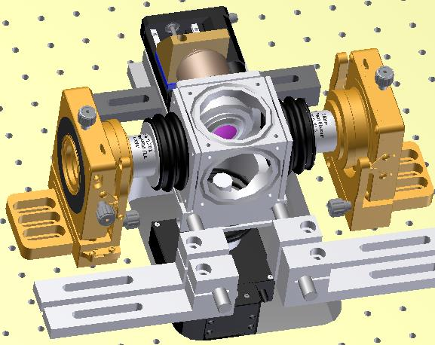
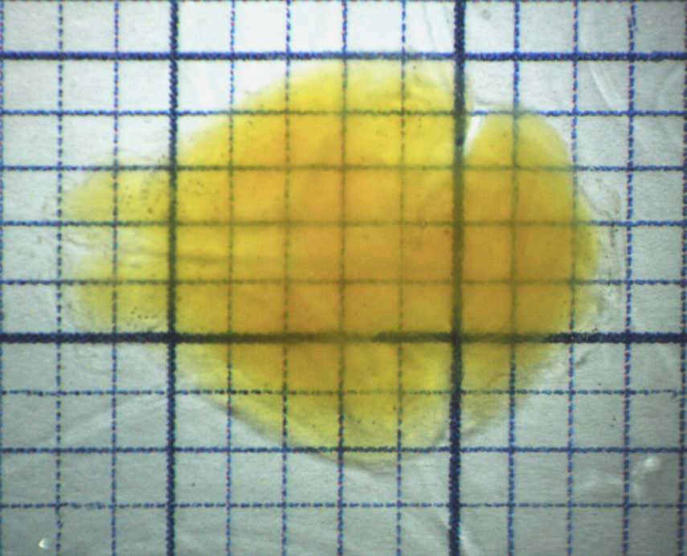
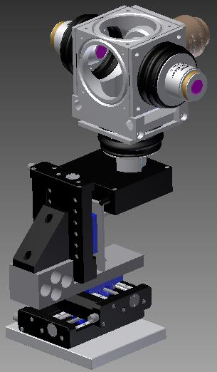
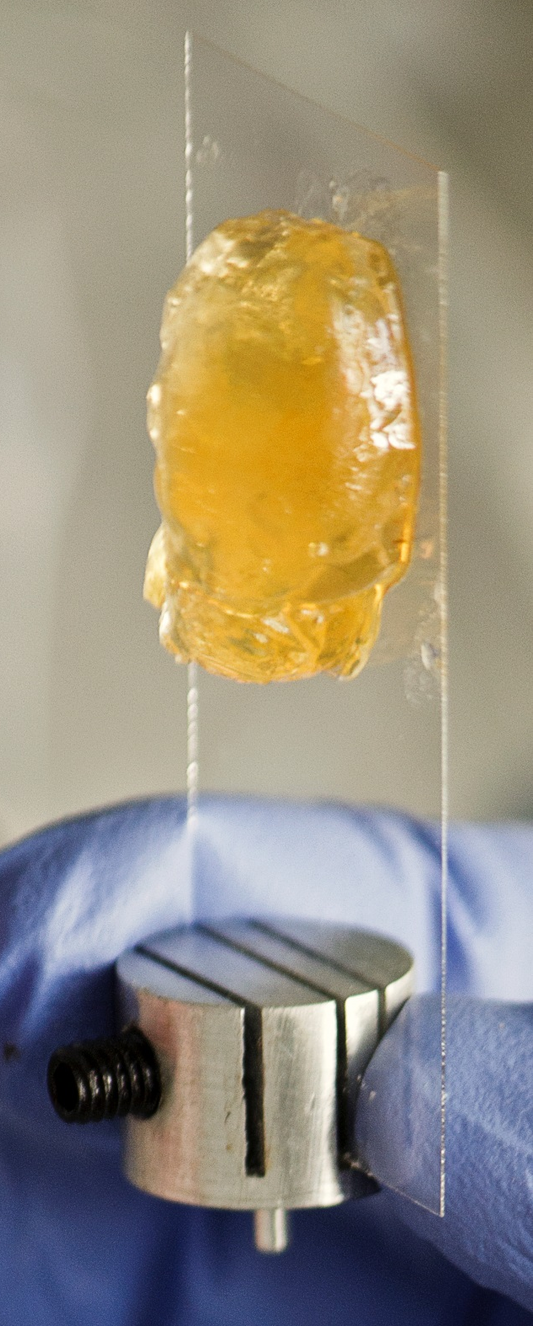
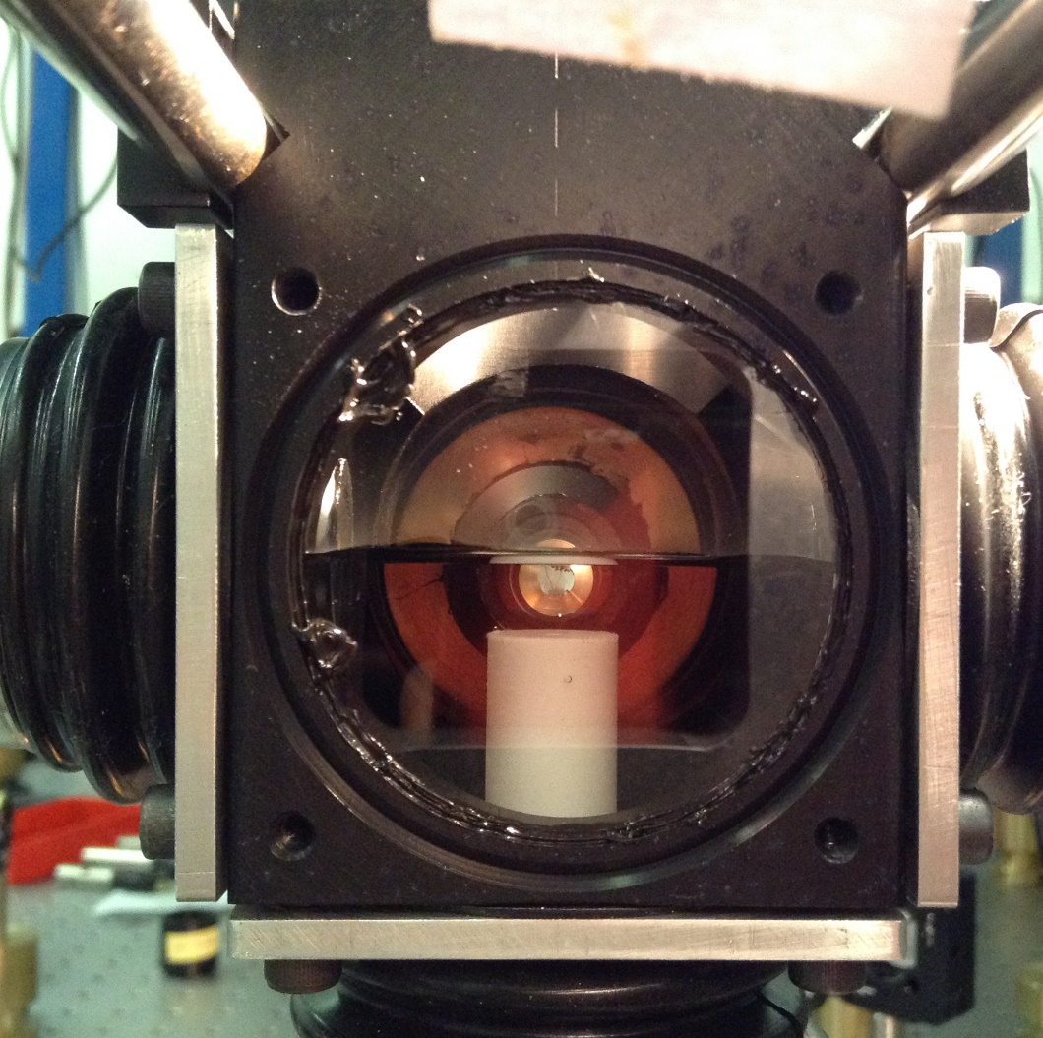
z
A
B
D
E
x
C

Slide 10
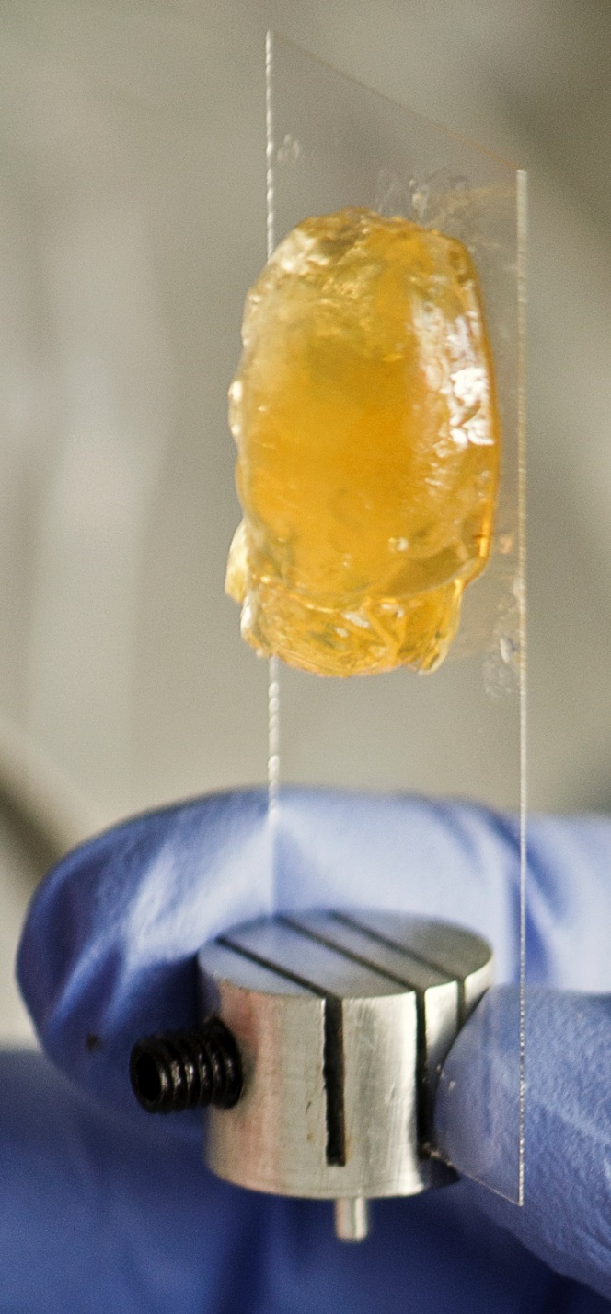

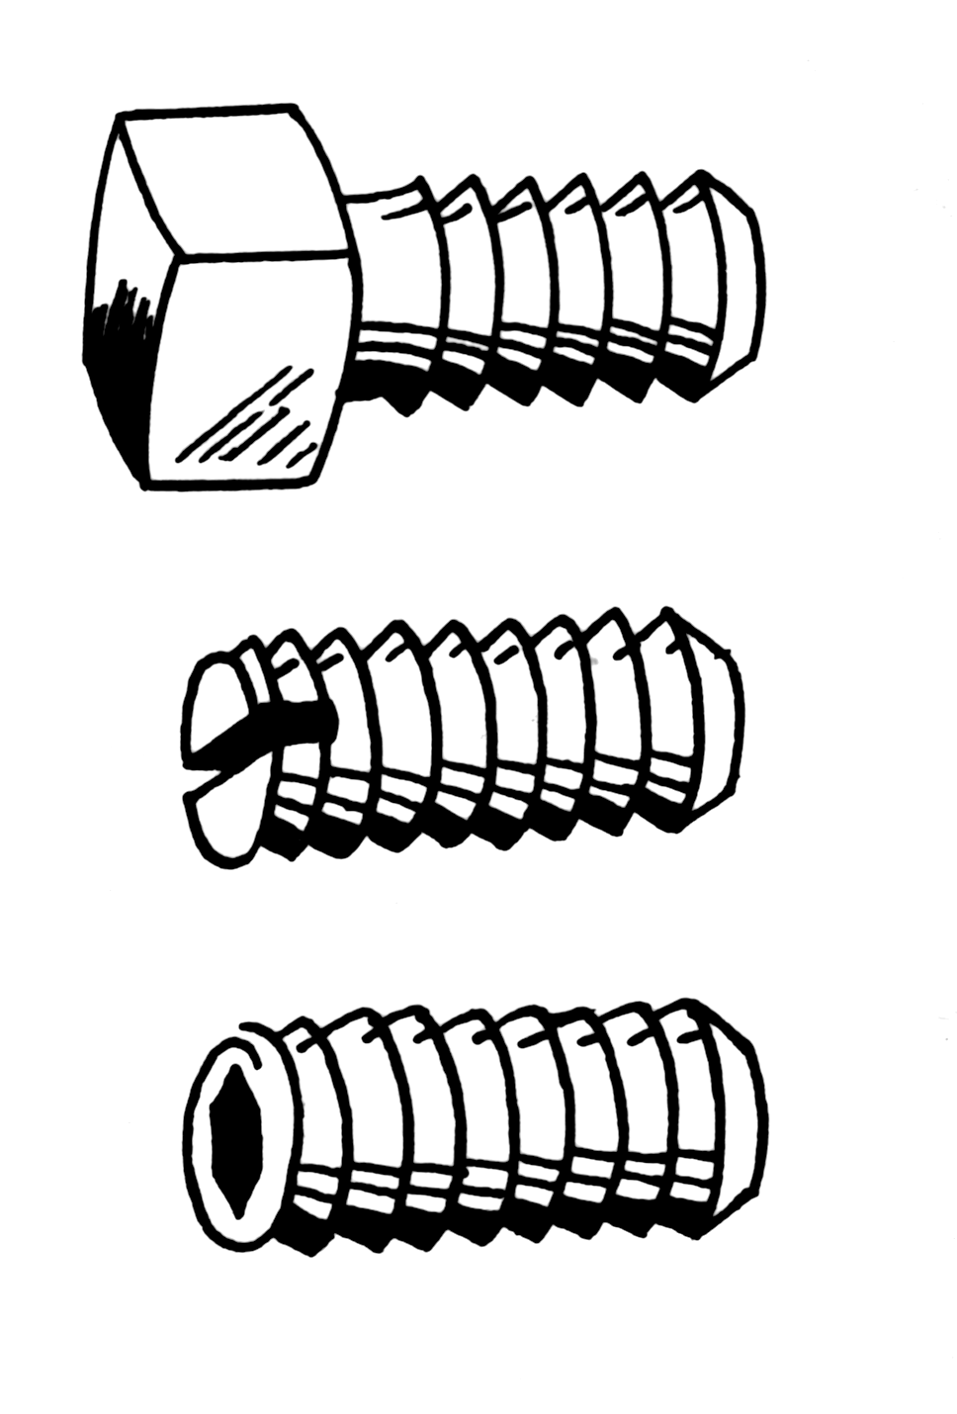
A
z
B
D
E
x
C

Slide 11
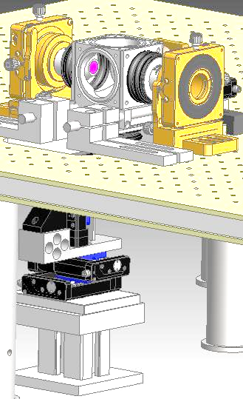
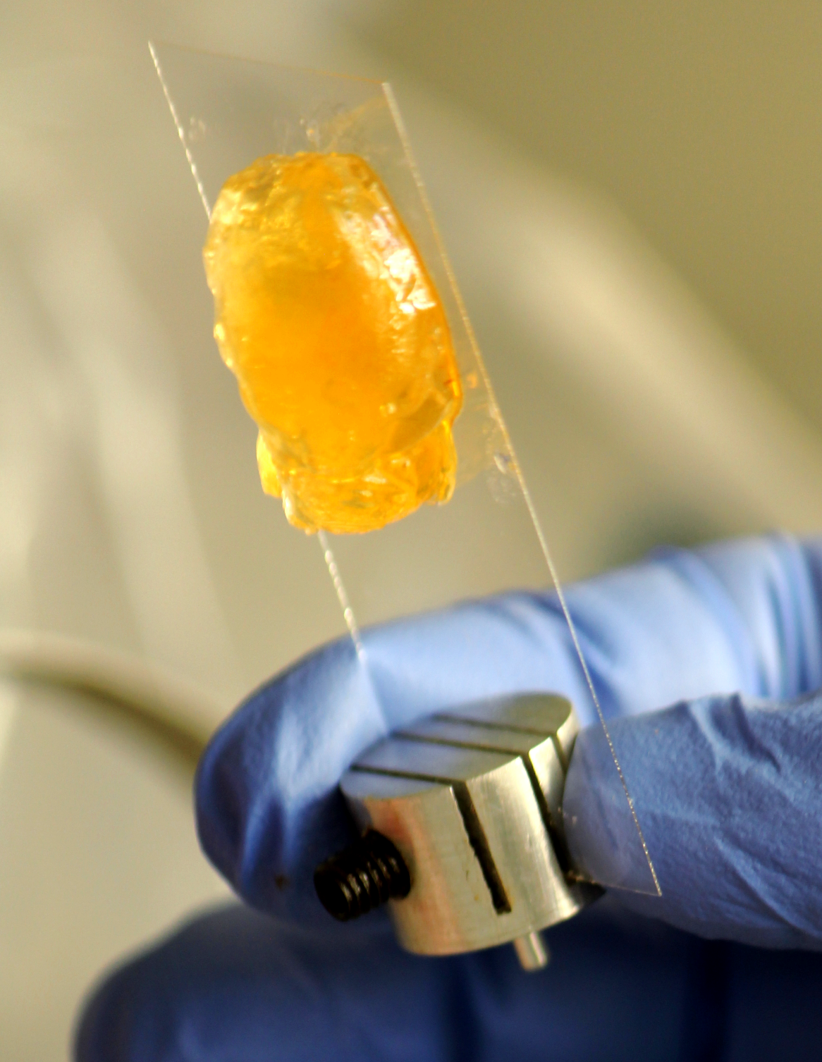
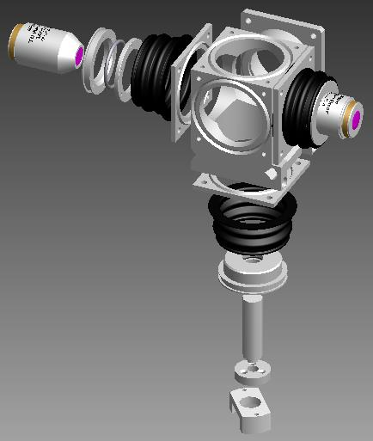

Slide 12
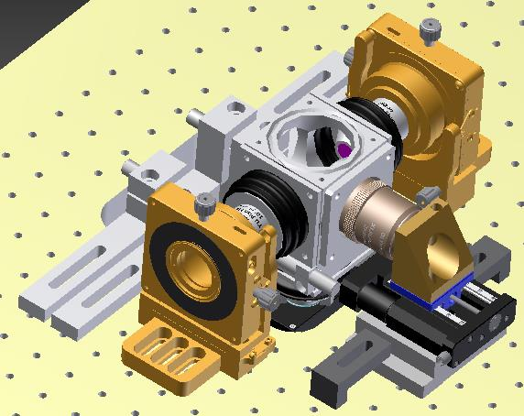
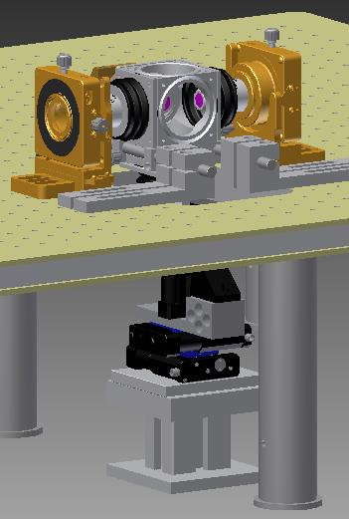
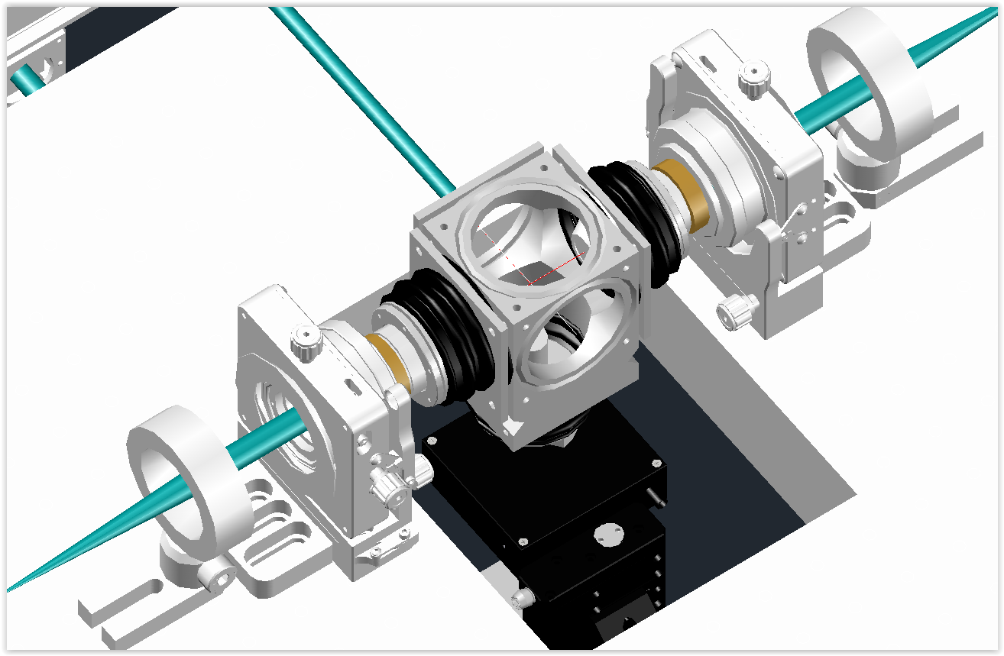

Slide 13
B

Slide 14
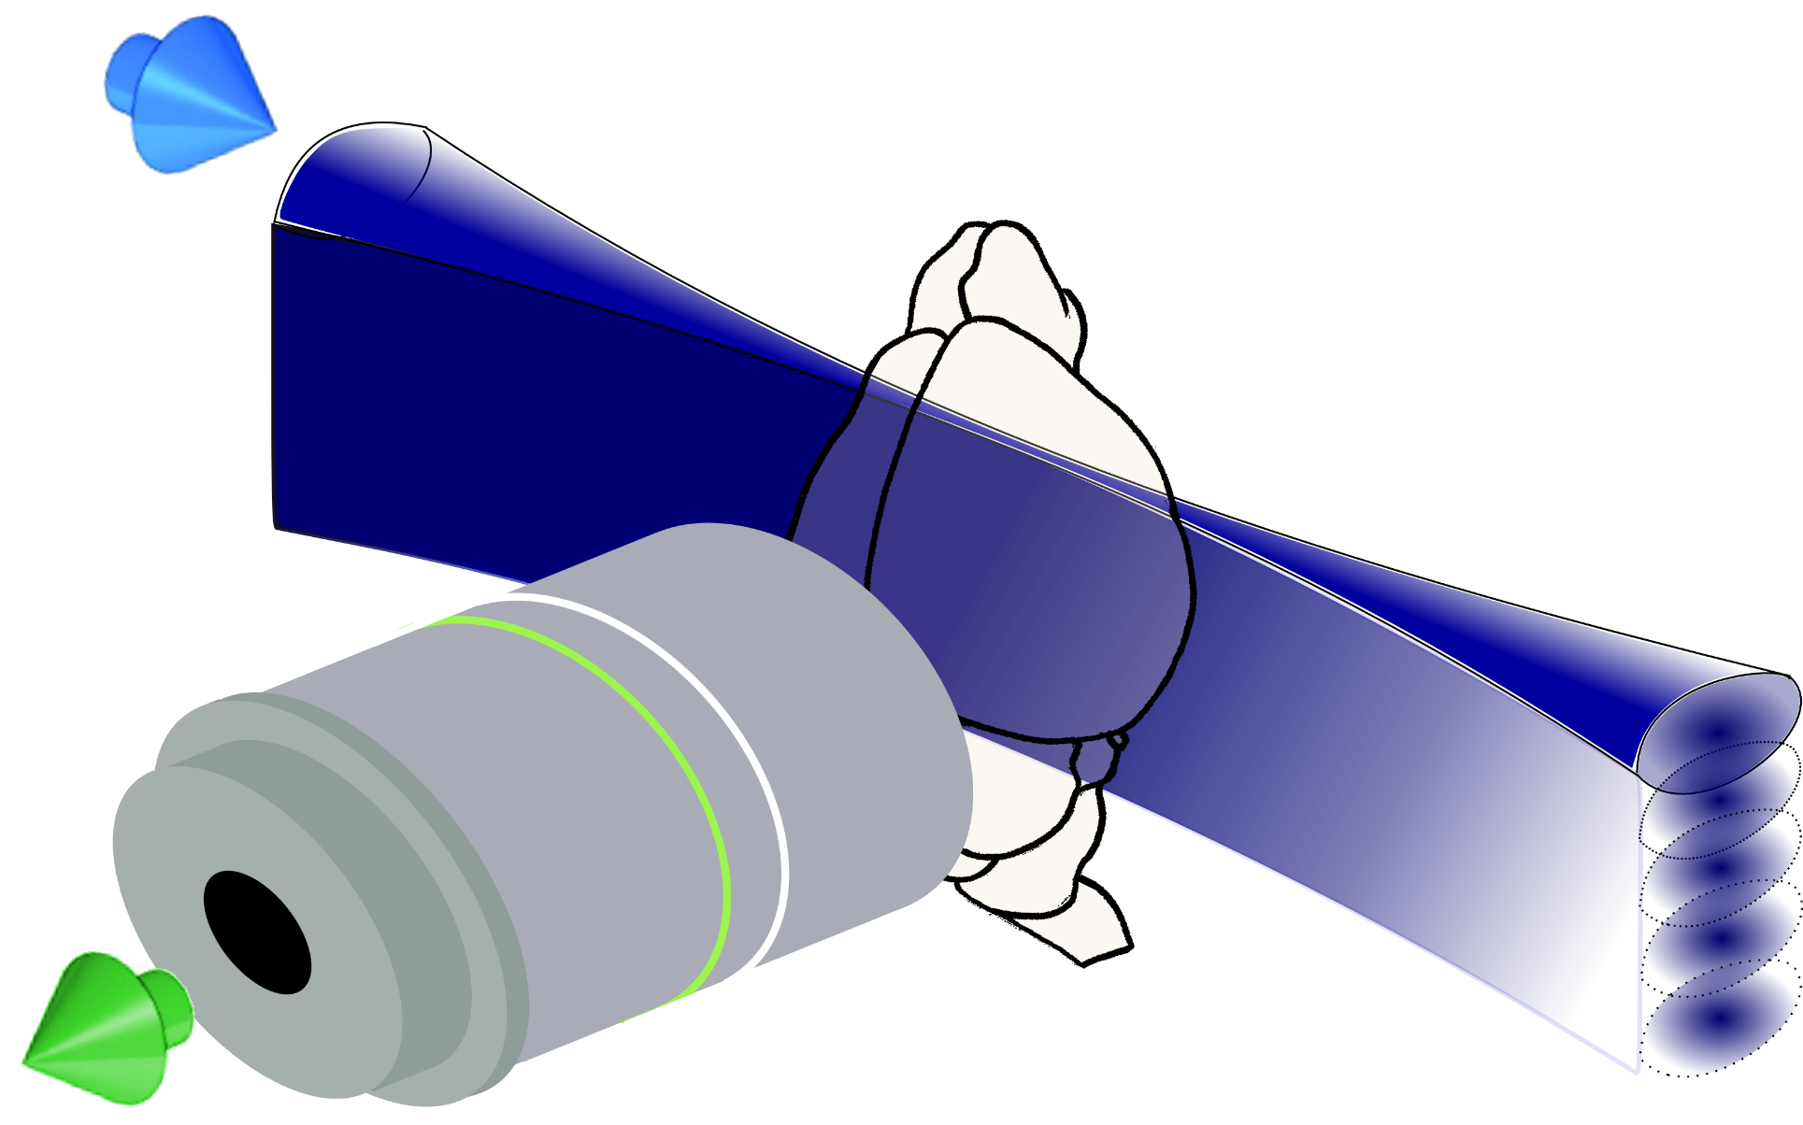

Slide 15
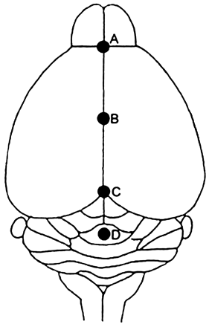
Camera
f 100
f 200
Olympus XLSLPLN25XGMP
25×, 1.0NA
WD: 8mm
f 100
DMM
f 80
f 300

Slide 16
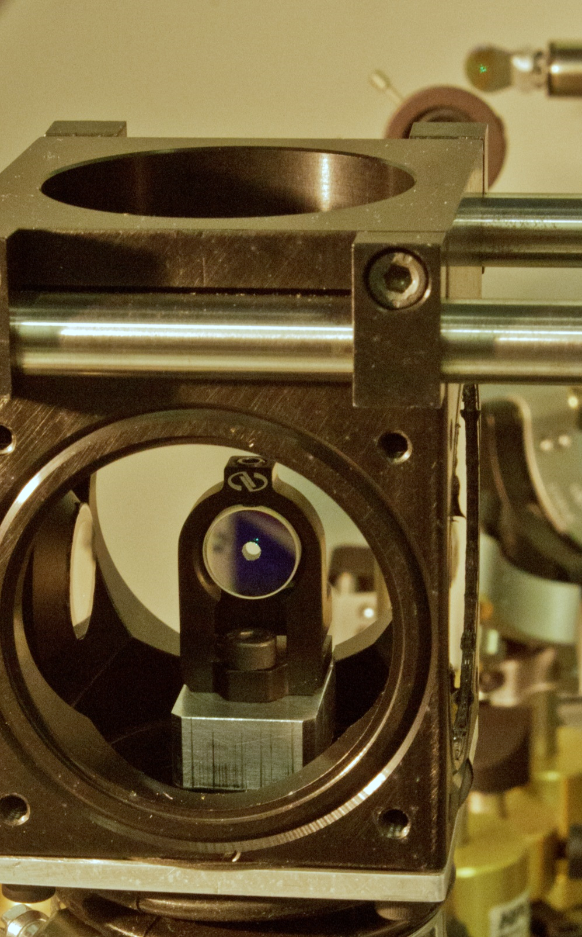
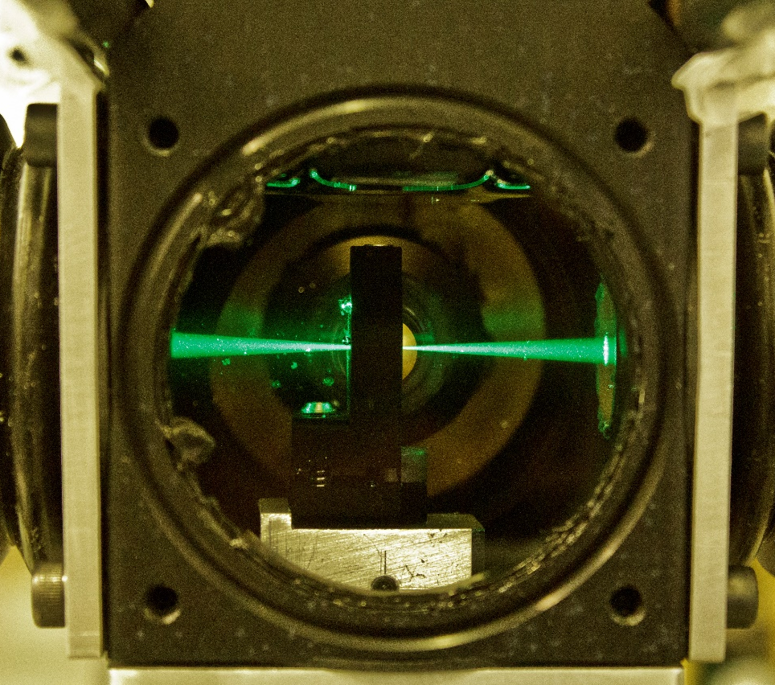
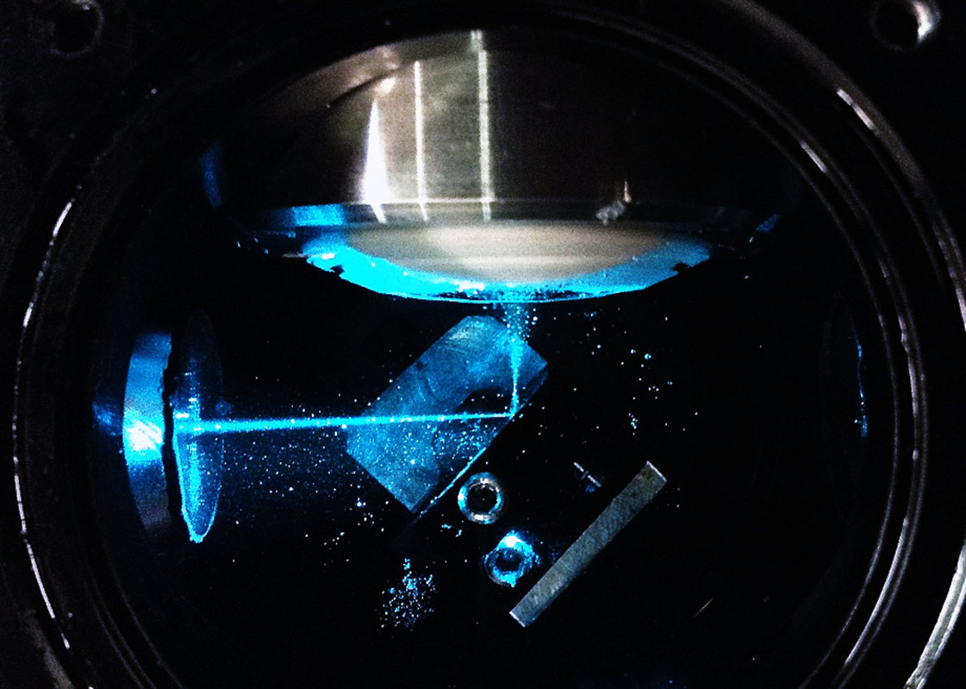
A
Camera
B
C
PBS
AD 350
AD 350
AD 200
D
AD 200
AD 200
v
AD 50
AD 100
AD 100
AD 50

Slide 17
Camera
1’ image plane
PBS
AD 350
AD 350
AD 200
AD 200
AD 200
1’ image plane
BFP
1’ image plane
BFP
BFP
galvo
v
galvo
AD 50
AD 100
AD 100
AD 50
object
plane
4f
4f

Slide 18
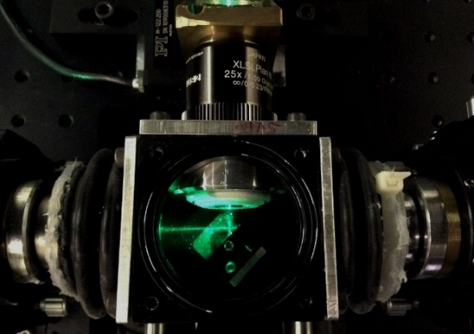

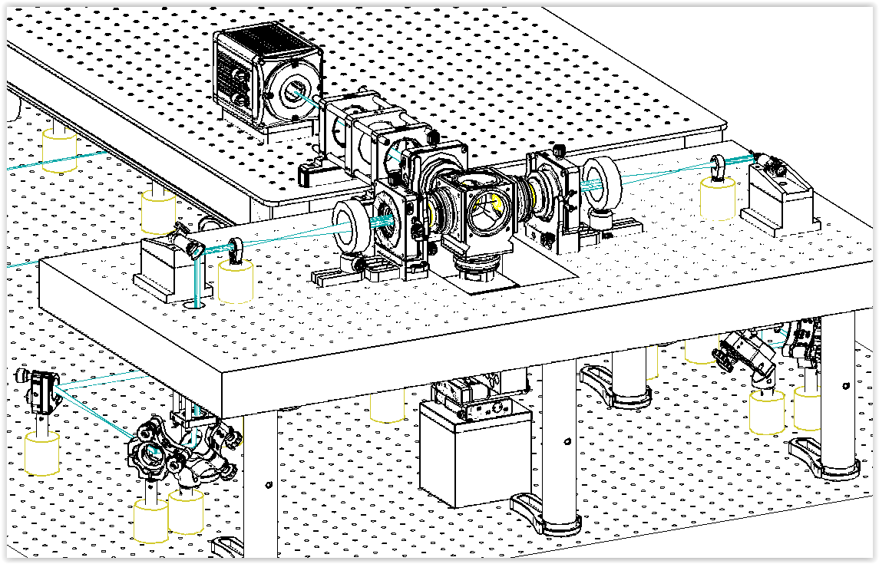
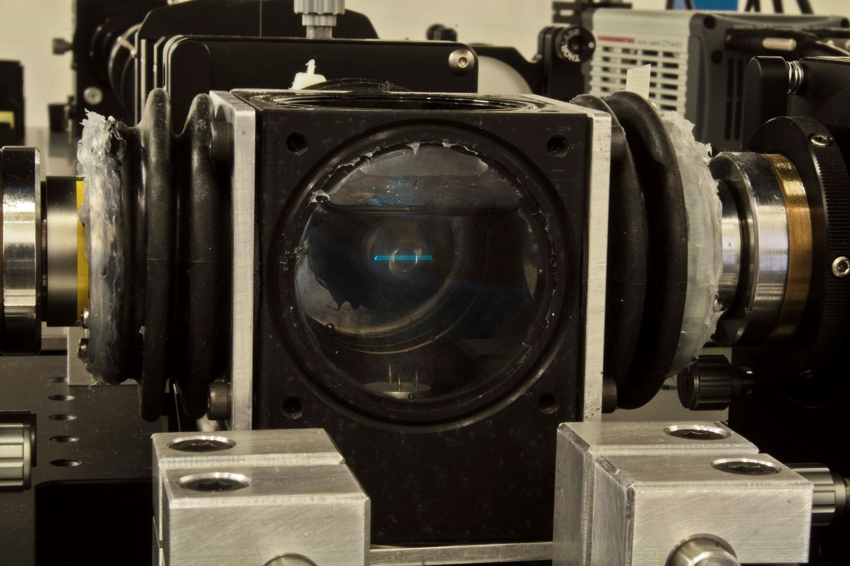
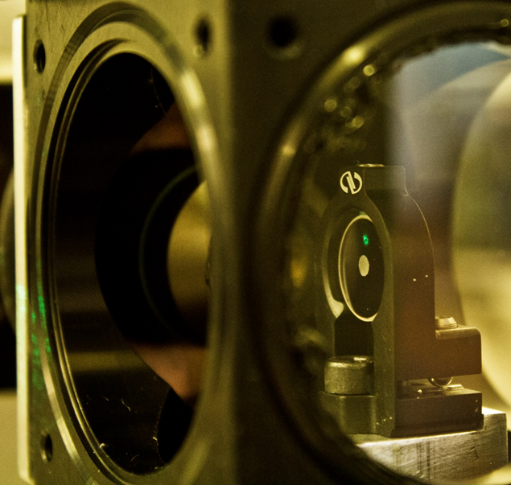

Slide 19
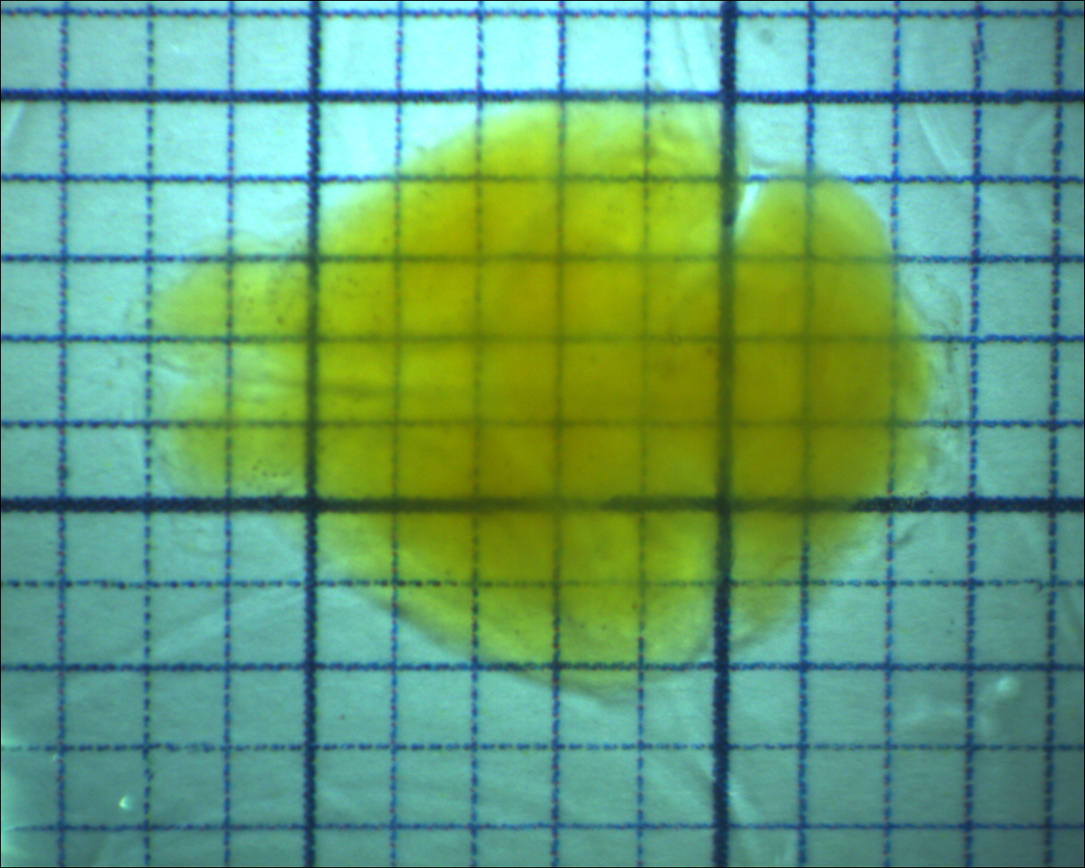

Slide 20
A
B
Tomo
Motor stages
USB
X
Y
Z
θ
Stack
Data Transfer
Laser
PC 1
Laser
RS232 Hub
Laser
Laser
AOTF
Laser
Camera
Motor Stages
USB
Galvo A
DAQ
Galvo B
BNC AO
Waveform
Generator
AOTF
(Shutter)
Custom Eletronics
Pulse
Amp.
Laser
Mod.
Int. BUS
BNC AO & DO
PC 2
Trigger pulses
DAQ
Board
Camera
CameraLink
Laser
Modulator
Galvo
Scanners
Lasers

Slide 21
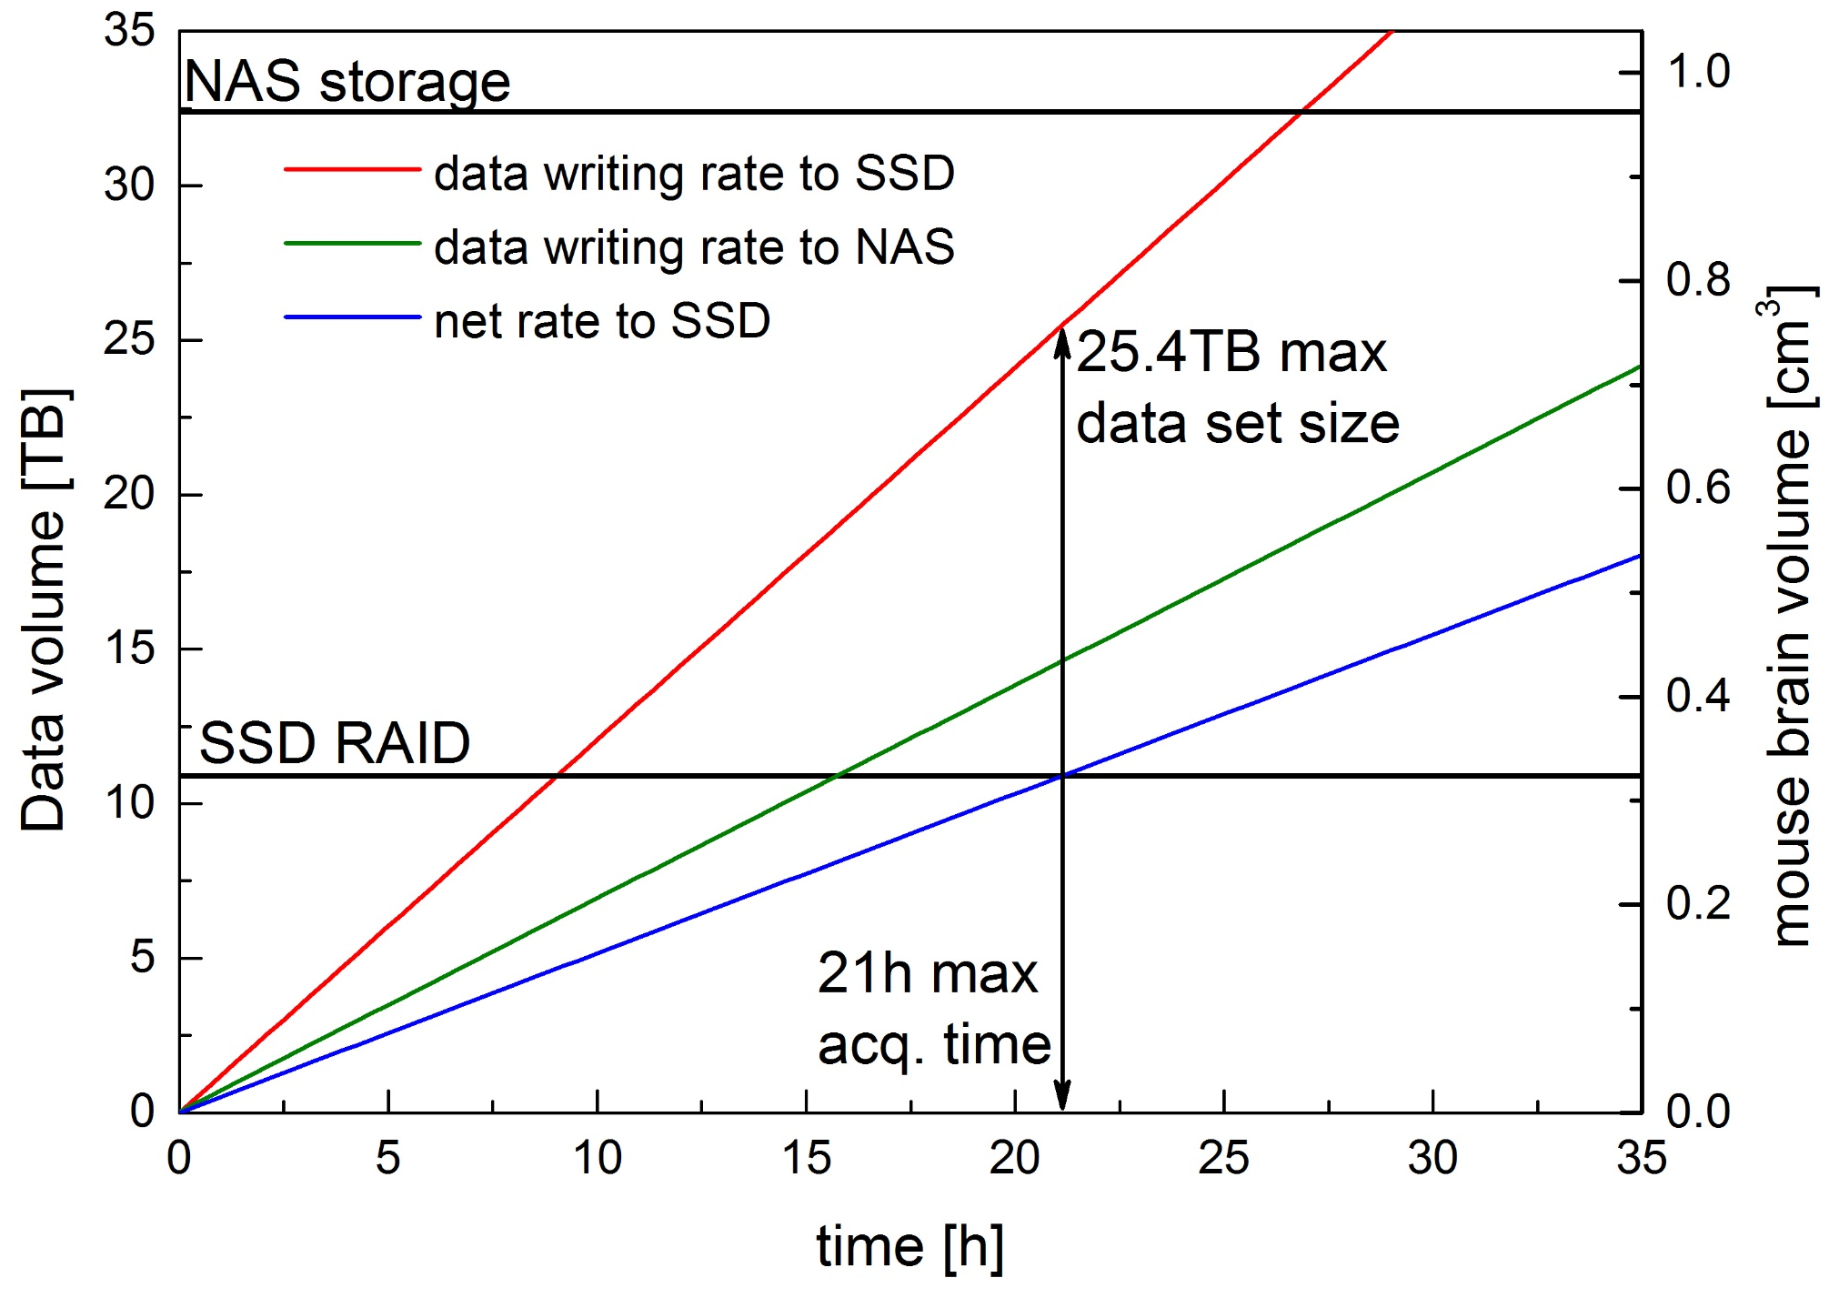
A
B
Camera
10 Gb Optical fibre
Supercomputing Centre
Bologna
CameraLink
board
10Gb network card
System
bus
Network-attached storage
32.4 TB
Data stream saving
Local SSD RAID 0
10.9TB
Data stream moving
Python script
Workstation
Laboratory

Slide 22
A
B
Camera
10 Gb Optical fibres
Remote repository
CINECA
CameraLink
board
10Gb network card
System
bus
Network-attached storage
32.4 TB
Raw data stream
Local SSD RAID 0
10.9TB
Data conversion stream
Transfer to remote repository
Workstation
Laboratory

Slide 23
Configure
Change hard-wired parameters (e.g. hardware ports names)
Update
Update run-time settings
(i.e. exposure time)
Main loop
Wait for user interaction and for messages from other components
Program start
Initialize
Set up hardware connections and load drivers
Terminate
Close all connections and drivers
Program end
Start
Begin grabbing images
Proceed
Grab images and decide to continue or not
Stop
Stop grabbing images

Slide 24
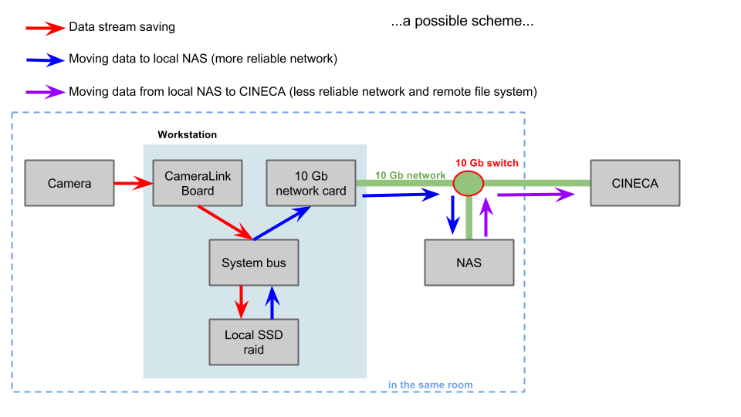
Data management
Python script from collaborators in Rome:
digitally downsample our images
transfer from SSD to NAS
Convert from .xcd to .tif
→ decrease of size by factor 10
32.4TB
10.9TB

Slide 25
Tomo
Stack
Data transfer
aquire image sweep:
# of frames
file name
Camera
move:
speed
step
SPIM imaging
AOTF
PI stages
Laser
DM mirror
cameralink
DAQmx
serial
USB
serial
Pockels cell
Galvos
Camera
AOTF
stages
Laser
DM mirror

Slide 26
Tomo
Stack
Data Transfer
Camera
Motor Stages
Waveform
Generator
AOTF
(Shutter)
DAQ
Board
Laser
Modulator
Galvo
Scanners
Lasers

Slide 28
AD f=100
AD f=100
AD f=50

Slide 30
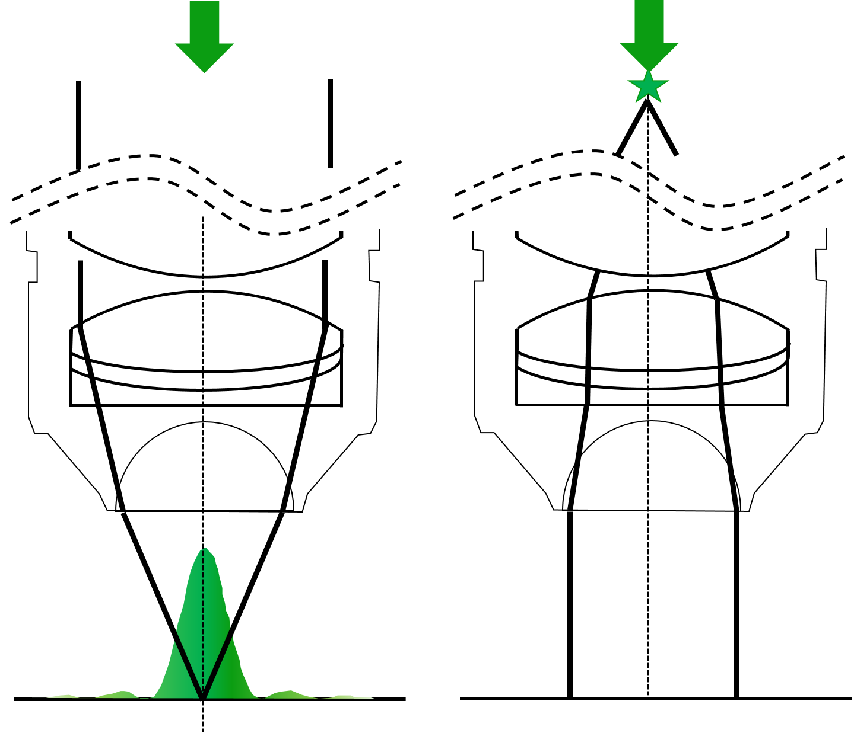
A
B
C
D

